Slide 1


Digital Design and Verification
For
SerDes System
Team members
Hassan Khaled Hassan
Abdelmagid Mohamed Abdelmagid
Alaa Salah Abd-Elfattah
Supervisor
Dr. Ahmed M.Zaki

Slide 2
Line 8b/10b Encoding
The 8b/10b line coding scheme is used to encode data for transmission over a communication channel. It's designed to ensure reliable data transmission and provide certain properties such as DC balance (equal number of 0s and 1s) and error detection.
10-Bit Symbols: In this scheme, data is encoded into 10-bit symbols. Each 10-bit symbol represents a combination of data and control information. This encoding is more efficient for transmission than using a straightforward binary representation
Notation "D05.2": The "D05.2" notation is a way to describe a specific 10-bit symbol within the 8b/10b scheme. Let's break it down:
"D" indicates that it's a data character.
"05" represents the first five bits of the data character in binary. In binary, "05" is "00101.“
".2" indicates that the last bit is "0" in binary.
One Byte Representation: While "D05.2" is a specific encoding within the 8b/10b scheme, it doesn't directly represent one byte of data. The 8b/10b scheme doesn't have a strict one-to-one mapping between its symbols and bytes of data. The scheme balances between 0s and 1s to ensure reliable transmission.

Slide 3
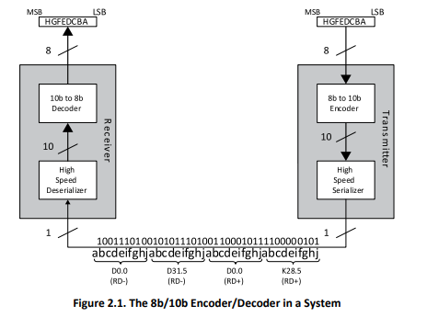
Line 8b/10b Encoding

Slide 4
Line 8b/10b Encoding
The Gen 1 PHY uses the 8b/10b transmission code.
PHY transmits information using an adaptive 8B/10B code to bound the maximum run length of the code .
Two types of transmission characters Data and Special .
Ordered Sets are known as combinations of transmission characters
MAC layer uses letter notation for describing information bits and control variable for example special symbol K28.5 here we just used letter and decimal numbers for describing not binary notation which we will explain in the following.
Unencoded PHY information byte is composed of eight information bits A,B,C,D,E,F,G,H and the control variable Z . This information is encoded by Encoder into the bits a,b,c,d,e,i,f,g,h,j of a 10-bit transmission character.
Information bit can hold only zero or one as value , control variable also can hold either the value D means “valid data byte” or the value K means “special code”

Slide 5
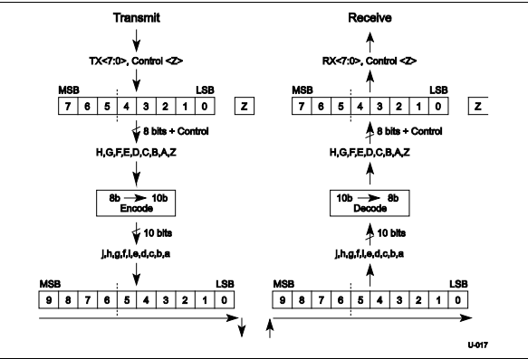
Line 8b/10b Encoding

Slide 6
DC-Balance and Run Length
A DC-balanced serial data stream means that it has the same number of 0s and 1s for a given length of data stream. DC-balance is important for certain media as it avoids a charge being built up
The run-length is defined as the maximum numbers of contiguous 0s or 1s in the serial data stream. A small run length data stream provides data transitions within a small length of data. Data transitions are essential for clock recovery.
The PLL of the CDR generates a phase-adjustable output clock from the reference clock input. Transitions on the serial data stream provide the transmission clock phase information to the PLL and allow the PLL to recover the transmission clock with the correct phase. Note that the reference clock input is always necessary for the CDR. The serial data stream embeds the phase of the transmission clock, not the clock itself. This reference clock comes from the receiver system, not the transmitter system.

Slide 7
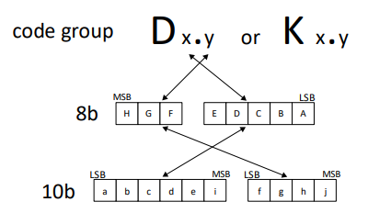
Code Mapping
The coding scheme breaks the original 8-bit data into two blocks, 3 most significant bits (y) and 5 least significant bits (x). From the most significant bit to the least significant bit, they are named as H, G, F and E, D, C, B, A. The 3-bit block is encoded into 4 bits named j, h, g, f. The 5-bit block is encoded into 6 bits named i, e, d, c, b, a. As seen in Figure ., the 4-bit and 6-bit blocks are then combined into a 10-bit encoded value.

Slide 8
Disparity

